Slide 1

Java Micro-Services Training Project
Pension management System Application
Efforts By :
Tina Jogi
Emp id : 2183672

Slide 2
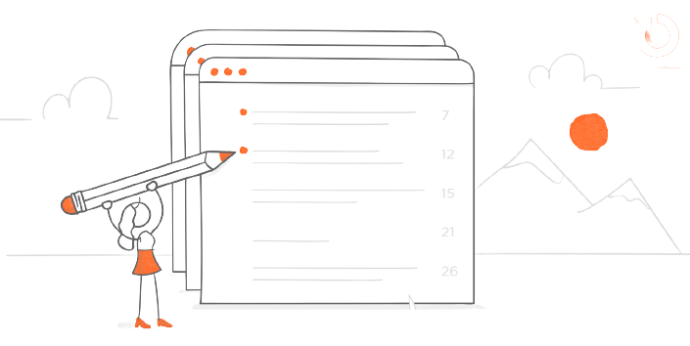
Table Of Contents
Introduction
Functionality
Implemented Methods
Architecture of Application(Spring-Boot Architecture)
Procedure
Dockerization
Steps of Dockerization
Requirements
Advantages
Conclusion

Slide 3

Introduction
The Application is built with an aim to provide the user with the system to manage their Pension related activities.
This application includes various function like create applicant , check status , check balance ,check application , issue pension ,load pension using spring boot framework.

Slide 4
Functionality
1. Add Pensioner/Employee Records
2. View Employee Records
3. Search Records(by id)
4. Calculate Pension(by their status)

Slide 5
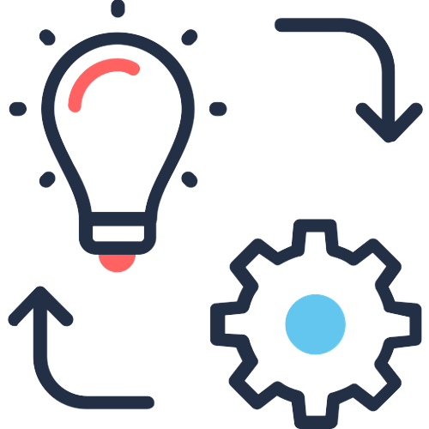
Implemented Methods
Create Applicant
Check Status(by id)
Check Balance(by id)
Check Application(by id)
Issue Pension
Load Pension

Slide 6
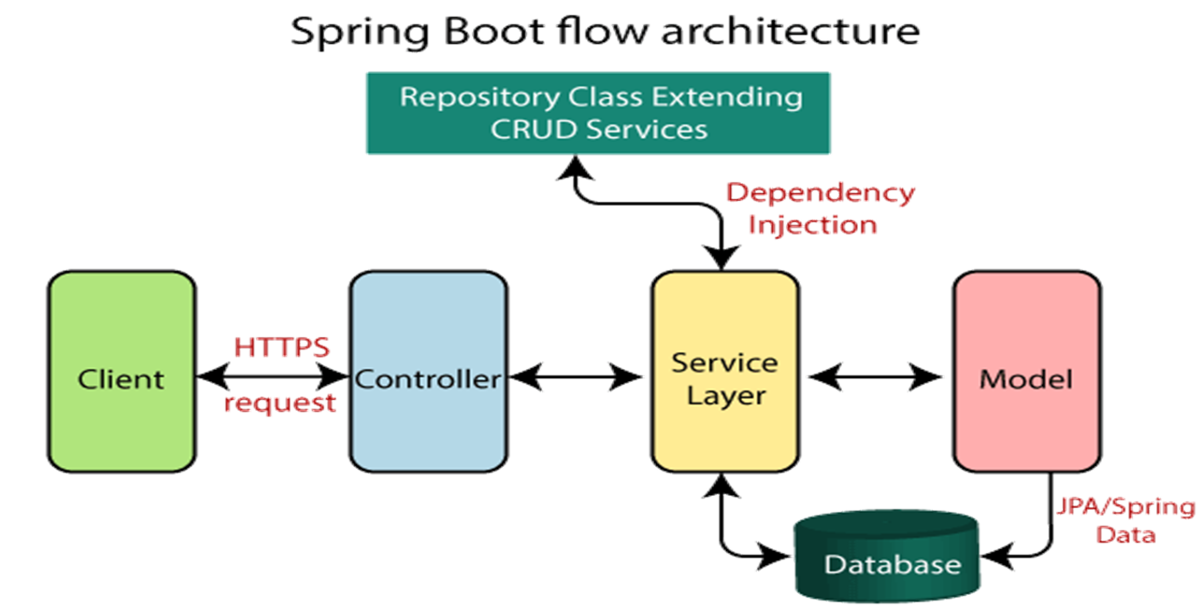
Architecture Of Application

Slide 7
Procedure
Project structure is created using Spring Initializr by adding all the required dependencies, plugins and versions.
Write required classes and methods.
Install all the dependencies with the help of command : mvn clean install
Start mysql image in docker using :
docker-compose -f docker- compose-mysql.yml up -d
Run the application by using maven spring-boot:run. Tomcat Apache server will start after running the project.
Work on the data in Postman by using url : https://localhost: port number/method name

Slide 8
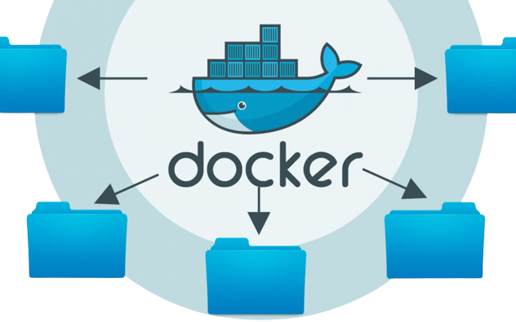
Dockerization
Dockerizing is the process of packing, deploying, and running applications using Docker containers.
Docker is an open source tool that ships your application with all the necessary functionalities as one package.
You can use Docker to pack your application with everything you need to run the application (such as libraries) and ship it as one package - a container.

Slide 9
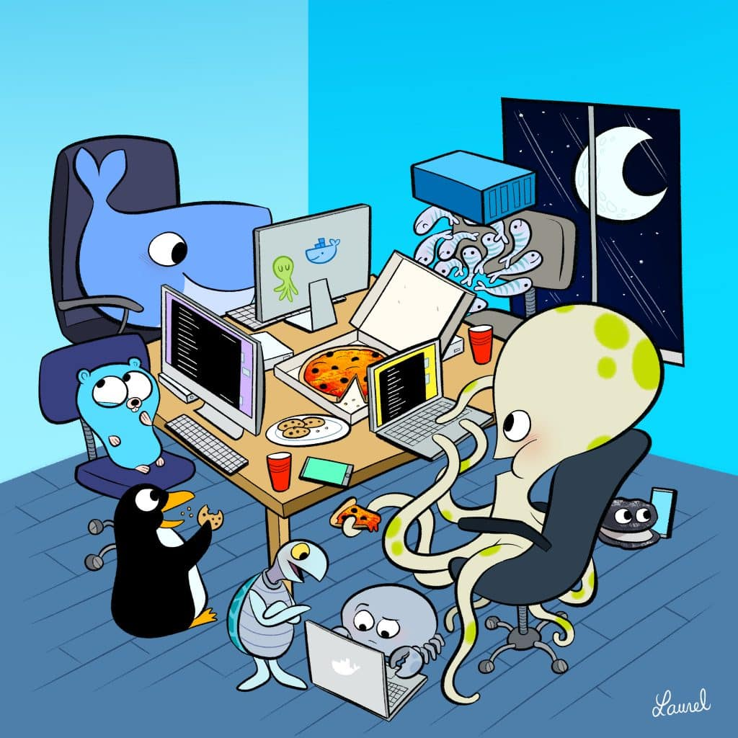
Steps of Dockerization
1. To perform Dockerization , Dockerfile is required in the application.
2. Start docker from docker desktop.
3. Run the command : mvn install dockerfile:build
4. Check docker desktop if image is created or not.
5. Push to docker hub from docker desktop.

Slide 10

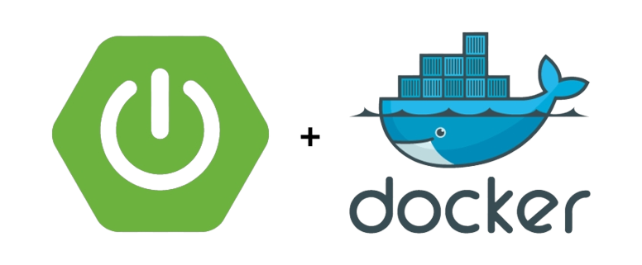
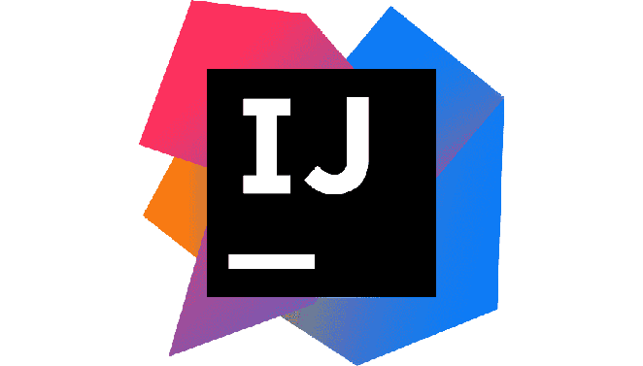
System Requirements
Software
Spring-Boot Framework
Necessary dependencies & database
Postman & Docker
Java SDK 11 or above
IDE(Intellij,Eclipse)
Hardware
Windows 10 or above
RAM 8GB

Slide 11
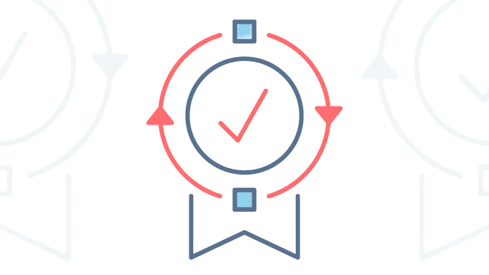
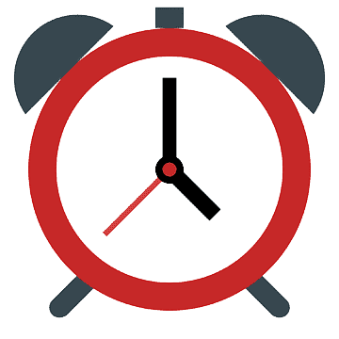

Advantages
User Friendly
Time -Saving
Reduced Data Redundancy
Easy to perform operations like add, update, search, delete etc

Slide 12

Conclusion
The Pension Management System Application is designed to manage pension activities for both applicants and pension admins.
The Application has eliminated the problems associated with the manual process.
Through the application user can view their details anytime they want, increasing their satisfaction.

Slide 13
Thank You.

